Slide 1
Smokeless Tobacco Kamran Siddiqi Professor in Global Public Health The University of York @kamsid66

Slide 2
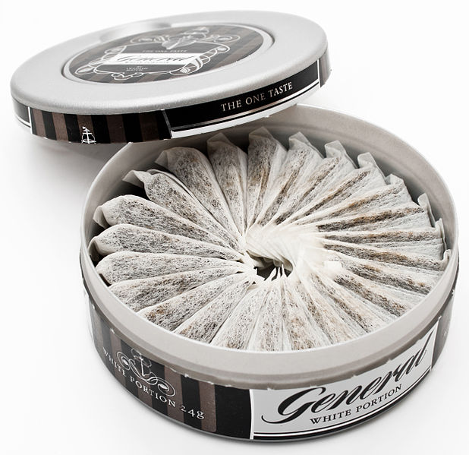
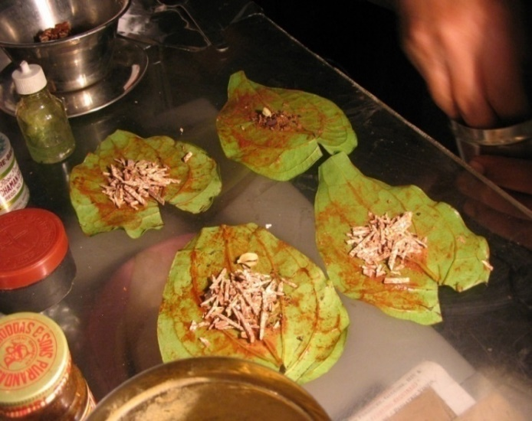
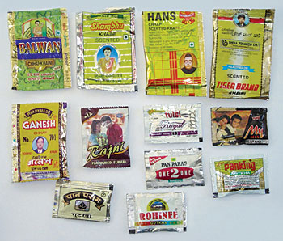
Smokeless Tobacco (ST)
“a number of products containing tobacco, which are consumed without burning through the mouth or nose”

Slide 3
Tobacco and its types

Slide 4
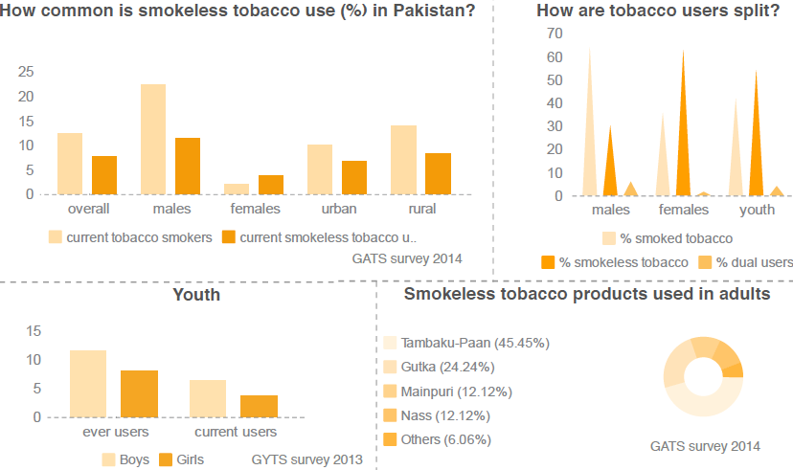

Slide 5
Smokeless Tobacco
Why does it need special attention?
Diversity
Demand
Harms
Supply chain
Policy gap

Slide 6
Diversity
Demand
Harms
Supply chain
Policy gap
What matters?
Tobacco plant, Storage, Curing, Processing, Additives
Determining?
Carcinogens: Tobacco-Specific Nitrosamines
Carcinogens: Polycyclic aromatic hydrocarbons, Aldehydes and Phenols
pH (Alkaline)
Nicotine content (mg/g)
Nicotina Rustica

Slide 7
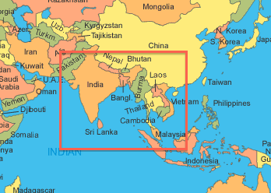
Diversity
Demand
Harms
Supply chain
Policy gap
South Asian Products
User prepared
Custom made
Manufactured
local and small scale
large industrial scale

Slide 8
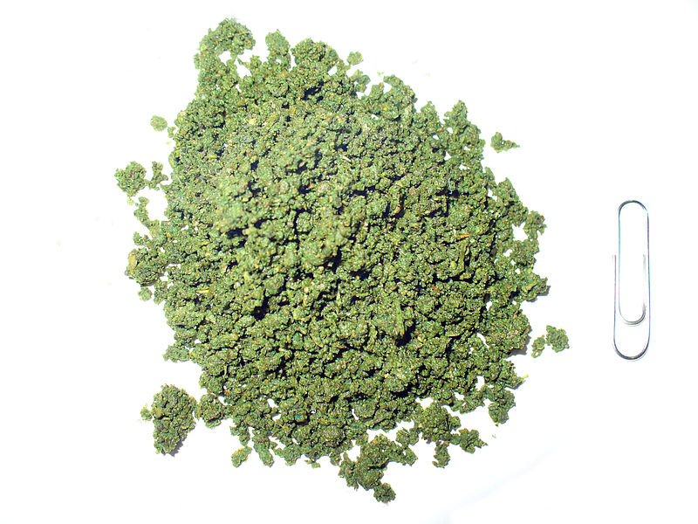
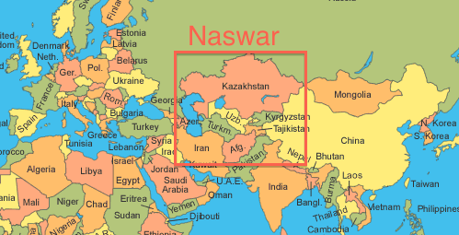
Diversity
Demand
Harms
Supply chain
Policy gap
Naswar, Nass, Nasway
Sundried powdered tobacco
Mixed with lime, ash + flavourings (cardamom), indigo
Placed between lip/cheek and gum

Slide 9
Diversity
Demand
Harms
Supply chain
Policy gap
Demand
Socio-cultural determinants
Addictive properties
Easy access
Little awareness about its harms

Slide 10
Diversity
Demand
Harms
Supply chain
Policy gap
Cotinine levels among tobacco users
Smokeless tobacco only (mean 11.7 dips per day) - 200 users Bangladesh
mean FTND-ST = 4.7
mean cotinine = 361 ng/ml
(Huque et al 2016)
Cigarettes only (mean 10.7 per day) - 207 users in Europe
mean FTND = 1.7
median cotinine = 113 ng/ml
(Etter J-F et al 2000)

Slide 11
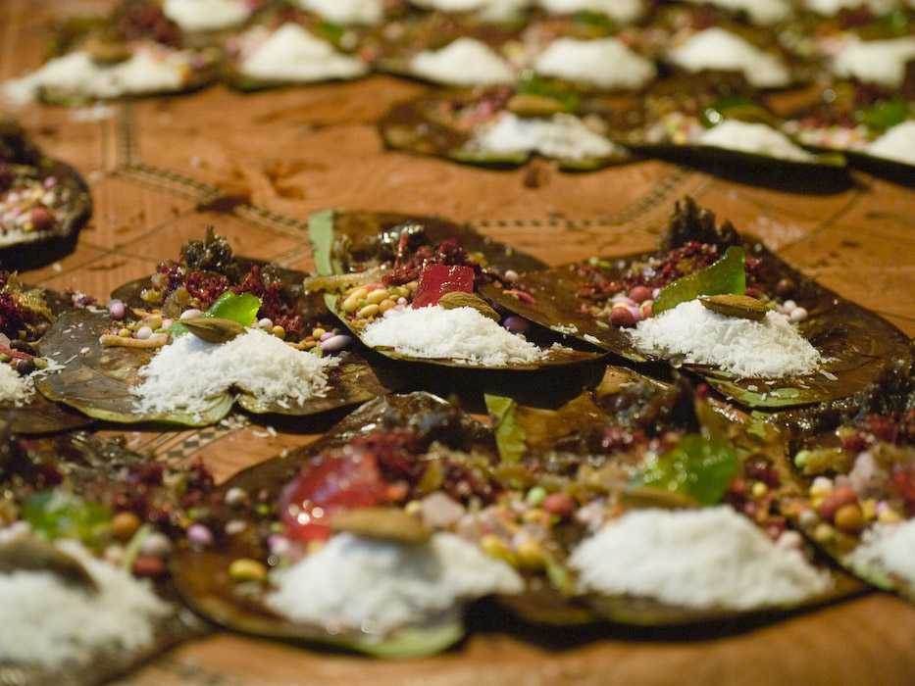
Diversity
Demand
Harms
Supply chain
Policy gap

Slide 12
ST in Women (Sindh)

Slide 13
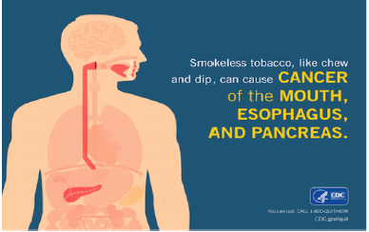
Diversity
Demand
Harms
Supply chain
Policy gap

Slide 14
Diversity
Demand
Harms
Supply chain
Policy gap
Global cancer statistics 2018: GLOBOCAN estimates of incidence and mortality worldwide for 36 cancers in 185 countries
Global cancer statistics 2018: GLOBOCAN estimates of incidence and mortality worldwide for 36 cancers in 185 countries

Slide 15
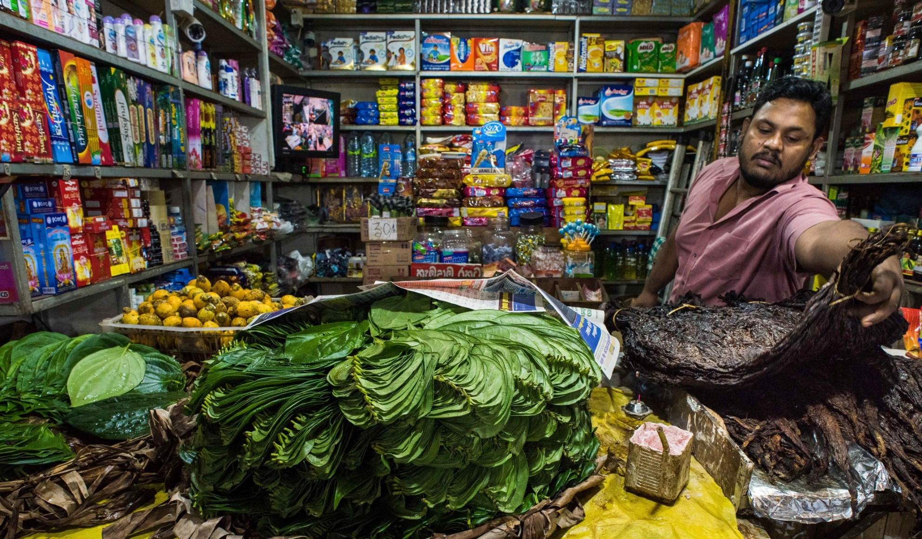
Diversity
Demand
Harms
Supply chain
Policy gap

Slide 16
Diversity
Demand
Harms
Supply chain
Policy gap
Policies: the bar is much lower for ST
very few regulate ST contents
ST taxes below cigarette taxes
ST health-warning requirements less strict than those for cigarettes
Implementation: the compliance is poor
despite bans on TAPS, products are promoted at point-of-sale and via media

Slide 17
Diversity
Demand
Harms
Supply chain
Policy gap
A comparative analysis of tobacco control laws in Pakistan for both smoking and ST

Slide 18
Diversity
Demand
Harms
Supply chain
Policy gap
A comparison between smokers and ST users in the way they are advised by health professionals in the last 12 months (Pakistan GATS 2014)

Slide 19
Summary - priorities
A comprehensive implementation of WHO FCTC
Applying uniform tax on all tobacco including ST
extending bans on advertising (inclusive of points-of-sale), promotion and sponsorship to ST
standardising packaging with pictorial warnings
ST-specific mass media campaigns
preventing children from buying and selling ST
regulating ingredients of ST products
offering support to those who wish to quit

