Slide 1
Exposure to Secondhand Tobacco Smoke: Experiences from Bangladesh
2nd International Pubic Health Conference
26 February 2020
Rumana Huque, PhD
University of Dhaka
Bangladesh

Slide 2
Presentation Overview
Tobacco use in Bangladesh
Tobacco control laws in Bangladesh
Exposure to second hand smoke
Study experiences
Policy implications

Slide 3
Tobacco use in Bangladesh
Bangladesh is one of the largest tobacco consuming countries in the world. ,
35% of people 15 years and older in Bangladesh consume tobacco.
Smokeless tobacco use is highly prevalent among adults; over 22 million people use smokeless tobacco and the rate of use (21%) is among the highest in the world.
Source:
World Health Organization. Report on the Global Tobacco Epidemic 2017. Country profile Bangladesh. Available at: http://www.who.int/tobacco/surveillance/policy/country_profile/bgd.pdf?ua=1
Global Adult Tobacco Survey, Bangladesh, 2017.

Slide 4
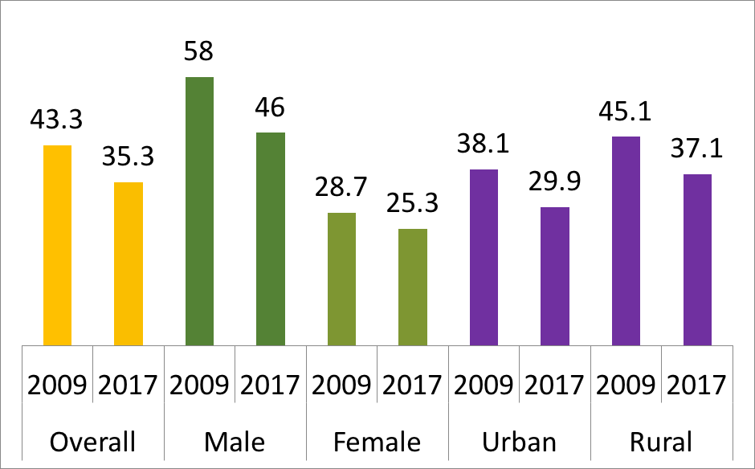
Tobacco consumption in Bangladesh (2009 and 2017)

Slide 5
Framework Convention on Tobacco Control (FCTC)
Demand reduction …
Article 6: Price and tax measures
Article 8: Protection from exposure to tobacco smoke
Article 11: Packaging and labelling of tobacco products
Article 12: Public awareness
Article 13: Banning tobacco advertising, promotion and sponsorship
Article 14: tobacco cessation

Slide 6
Supply reduction …
Article 15: Illicit trade in tobacco products
Article 16: Sales to and by minors
Article 17: support for economically viable alternative activities

Slide 7
Tobacco control laws in Bangladesh

Slide 8
Major achievements
1988: First written warnings included in tobacco packs
1988: Ban tobacco advertisements at government media (BTV, Bangladesh Radio)
2003: Signed WHO FCTC
2004: Ratified FCTC
2007: Established NTCC
2007: Formed Taskforce at National, District and Sub-district for tobacco control law implementation
2010: Bangladesh Bank banned loan for tobacco industries
2011: Bangladesh Chemical Industries Corporation (BCIC) banned to provide subsidized fertilizer to BATB
2015: 7th Five Year Plan included tobacco control as a strategy to combat non-communicable diseases
2017: 4th Health, Nutrition and Population Sector Programme includes tobacco control as a component to combat non-communicable diseases

Slide 9
What is second-hand smoke (SHS)?
Second hand/passive smoking means breathing in smoke that is coming out from burning end of cigarettes or biri, or that a smoker is breathing out from their mouth.
More than 85% of tobacco smoke is invisible and has no smell.
There are 7000 chemicals in SHS.
Health risks include lung cancers, coronary heart disease, stroke, chronic obstructive pulmonary disease, oral and pancreatic cancer.

Slide 10
Exposure to SHS: GATS 2017

Slide 11
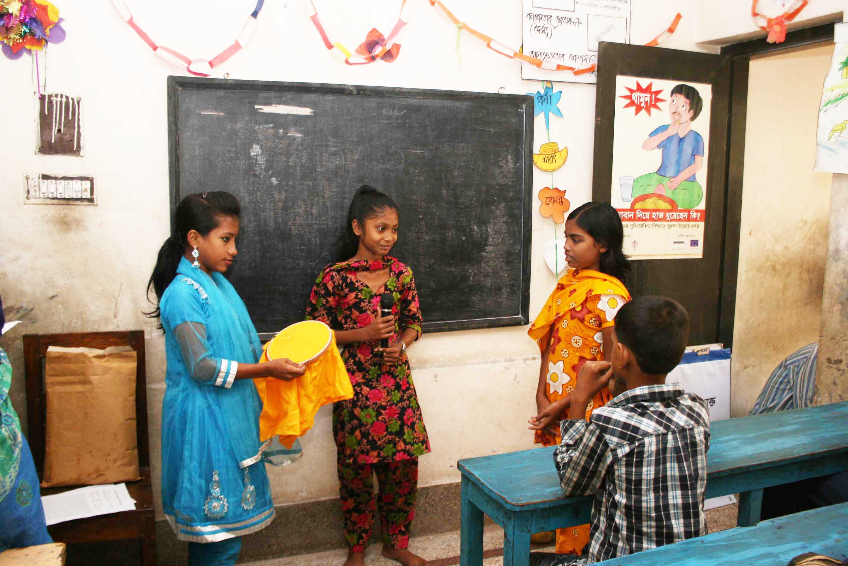
Study experiences
School-based intervention (CLASS)
Community-based intervention (MCLASS)
Facility based intervention (IMPRESS)

Slide 12
Study experiences
Reasons of high SHS exposure at home:
Lack of knowledge
Gender relationships
Sense of helplessness of women
Unsupported by other family members
Little health professional input
Does the intervention work?
The intervention(s) were acceptable and feasible to deliver.
The trial findings appear to favour the intervention.

Slide 13
Study experiences
Knowledge translation
Policy influence
Sustainability
Media engagement

Slide 14
Policy Implications
Despite having a ban on smoking in public places, SHS exposure in Bangladesh remains very high.
There is an urgent need to reduce exposure to SHS
Implementation of laws
Awareness raising

Slide 15
Thank You

