Slide 1
Khyber Pakhtunkhwa Public Heath Reference Laboratory
Dr Shaheen Afridi
Director Public Health,
Department of Health,
Khyber Pakhtunkhwa

Slide 2
Background
In order to cater the public health needs of the provinces, the need for provincial Public health labs was recognized.
Such a laboratory would perform testing for diseases of public health importance, liaise with health department for prevention, surveillance and control of notifiable diseases.
One of the features of this lab would be to integrate with IDSR and provide real-time communication with the health workers.

Slide 3
Background
A mission of NIH, WHO, Health Department, and CDC visited various sites in KP for feasibility of KP Public Health Lab in 2016.
These sites included Hayatabad Medical Complex, Provincial TB lab, and Khyber Medical University
After detailed laboratory assessment, the team chose IBMS, KMU for establishments of KP-PHRL

Slide 4
Background
A tripartite MoU between department of health, NIH, and KMU was signed.
As part of the MoU,
KMU provided laboratory infrastructure, human resource andshared equipment (20 laboratory spaces spanning 10,000 square feet, 4 consultants and 6 technicians)
NIH provided equipment, consumables and reagents and training of the human resource
Health department provided the resources for operations

Slide 5
Background
Department of Health also provided a grant-in-aid of 8 million PKR for renovation of the laboratory
The renovation work has nearly been completed and finishing work is remaining.

Slide 6
Laboratory systems validation pilot exercise
Before initiating the formal laboratory functions, it was decided to perform a pilot exercise to test
Pre-analytical
Analytical
Post-analytical testing

Slide 7
What do we have so far
Seven laboratories (routine haematology and chemistry, microbiology, NCD, Food and environment, Viral serology, molecular biology, and special pathogens and AST)
70 percent of equipment proposed for minimum function have arrived and installed.
This makes up most of viral serology and molecular biology laboratories.

Slide 8
Keeping in view of the available equipment and training, we chose to test lab systems for dengue testing
Designed Dengue SOPs
Pre-analytical SOPs – collection, transport, request form
Analytics SOPs – Equipment logs, Worksheets
Post-analytics SOPs – reporting criteria

Slide 9
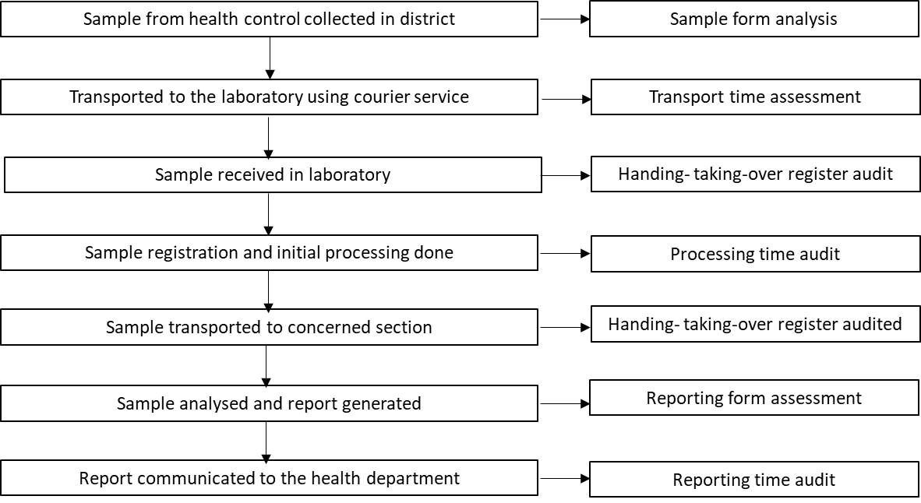
Methodology
District Peshawar and Nowshehra
Courier and personal
One technician only
Initial processing not done
In respective sections. Consultant advice
Request+worksheet+result
Whatsapp + dispatch

Slide 10
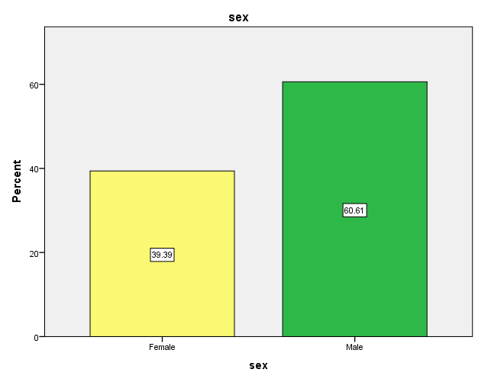
Results
Total 33 samples received
3 From district Nowshehra, 30 from Peshawar (BHU Sarband, KTH, Kuwait TH)
Age of The patients
N= 33
Mean | 33.16
Std. Deviation | 16.038
Minimum | 10
Maximum | 70

Slide 11
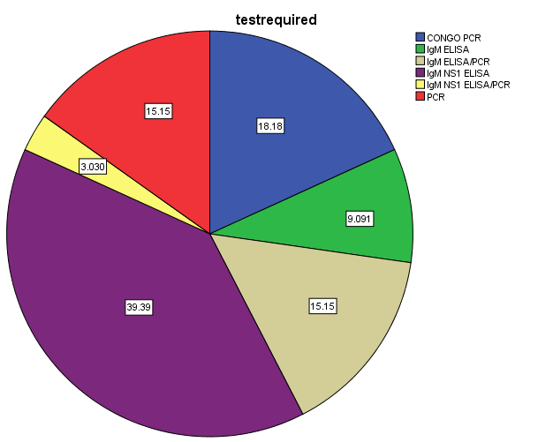
Distribution of test requests
Tests | Frequency | Percent
CONGO PCR | 6 | 18.2
IgM ELISA | 3 | 9.1
IgM ELISA/PCR | 5 | 15.2
IgM/NS1 ELISA | 13 | 39.4
IgM/NS1 ELISA/PCR | 1 | 3.0
PCR | 5 | 15.2
Total | 33 | 100.0
We started receiving Congo and Ricketsia samples as well.
These were dispatched to NIH in triple packs – packing practice, patient information

Slide 12
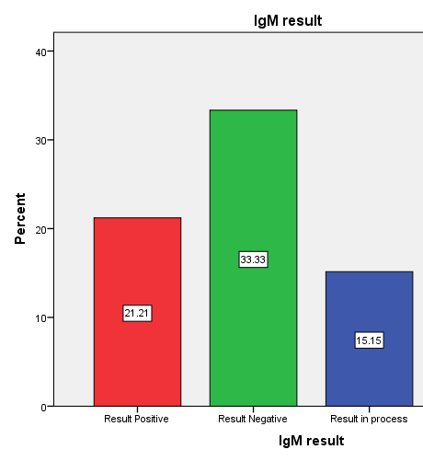
Dengue IgM ELISA
23 requests – 7 positive for IgM
Kit positive control issues
Batch processing – Thrift vs quick turnaround time

Slide 13
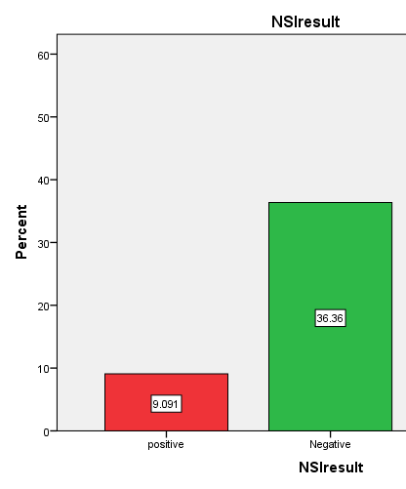
Dengue NS1 results
Total requested 15 – 3 positive 12 negative
Batch processing – thrift vs turnaround time

Slide 14
Dengue qPCR results
Total samples tested (8)
1 positive for serotype 3
Samples sent to NIH for confirmation
No confirmation yet

Slide 15
Turnaround times
Statistics
Processing time audited in days
N | Valid | 33
 | Missing | 0
Mean |  | 4
Std. Deviation |  | 6
Minimum |  | 2
Maximum |  | 19

Slide 16
Strengths
System successfully tested. No sample was lost, broken, or sent to wrong laboratory
SOPs designed and implemented
Waste management system started
Equipment tested
Requirements for consumables identified
Dissemination of information regarding PHRL
Technicians knowledge and skills refreshed

Slide 17
Weaknesses
Sample transport not yet uniform
Reception not yet complete
LMIS yet to be installed
Dedicated staff yet to be hired
Supply chain of consumables is not smooth
Incomplete request forms
Patient traffic in KMU

Slide 18
Opportunities
Skills can be applied for other tests as well
Lays out a platform for outbreak investigation
Better preparedness before the next outbreak

Slide 19
Threats
Doctors and staff may lose motivation

Slide 20
Recommendation
LMIS
Courier contracts
Staff
Supply chain and inventory management

Slide 21
Agenda points
Equipment is installed
Rest of the equipment will come. Issue of one vendor. Dr Faheem Solved it.
Certain reagents from NIH requested. Assured that they will come.
ED NIH visited our lab and was happy with the way things are moving.
Received training in Dengue Management, Biosafety and Biosecurity
Would soon start recruiting staff for KP-PHRL
Dengue exercise
LIMS

Slide 22
PHRL Quotation
General lab items
S.NO | Item Name | Unit Price | Quantity Required | Total Cost
1 | Lab coats | 440 | 22 | 9680
2 | WASTE BINS | 2750 | 3 | 8250
3 | NEEDLE CUTTER | 220 | 2 | 440
4 | BLUE TIPS 1000/PACK | 165 | 17 | 2805
5 | PIPPETE 1 ML | 110 | 1 | 110
6 | RED TOP CONTAINER | 11 | 100 | 1100
7 | GLOVES BOX | 495 | 45 | 22275
8 | TISSUE ROLL | 132 | 46 | 6072
9 | PLASTIC GLOVES | 5.5 | 23 | 126.5
10 | ETHANOL 2.5 L | 2750 | 20 | 55000
11 | Plane tubes | 8.8 | 200 | 1760
12 | EDTA TUBES | 6.05 | 300 | 1815
13 | GEL TUBES | 8.8 | 400 | 3520
14 | SAMPLE RACK | 715 | 10 | 7150
15 | SANITIZER | 3850 | 7 | 26950
16 | SPILL KIT | 9500 | 3 | 28500
17 | DISINFECTANTS /ABSORBENTS | 300 | 5 | 1500
18 | Yellow tips 1000/pack | 165 | 11 | 1815
19 | Cryo box | 770 | 12 | 9240
20 | Eppendroff tubes 1.5 ml 1000/box | 1650 | 4 | 6600
21 | White tips (pcr tips) 1000/pack | 1980 | 6 | 11880
22 | Falcon tubes 50 ml 20/pack | 22 | 5 | 110
23 | Falcon tubes stand | 1100 | 5 | 5500
24 | Falcon tubes 15ml 20/pack | 33 | 5 | 165
25 | Leishman stain commercially prepared | 1650 | 2 | 3300
26 | METHANOL | 1320 | 1 | 1320
27 | SLIDE BOX | 132 | 7 | 924
28 | SLIDE FOLDER | 319 | 3 | 957
29 | SHAKER | 19800 | 1 | 19800
31 | COVER SLIPS BOX | 1650 | 5 | 8250
32 | CIDAR WOOD OIL | 6050 | 2 | 12100
33 | BLEACH | 275 | 3 | 825
34 | SYSMEX XP100 CONTROL (HIGH, NORMAL) | 9900 | 1 | 9900
35 | STAINING RACK | 715 | 2 | 1430
Total |  |  |  | 271169.5

Slide 23
1 | Measels Elisa kit | 53900 | N/A | 53900
2 | RNA extraction kit 250 preps | 93500 | 1 | 93500
3 | DNA Extraction kit 250 preps | 132000 | 1 | 132000
8 | CENTRIFUGE MINI | 16500 | 1 | 16500

Slide 24
Furniture
S.NO | Item Name | Unit Price | Quantity Required | Total Cost
1 | CHAIRS | NA | NA
2 | Cabinets | 9720 | 9 | 87480
2 | PHELBOTOMY CHAIR | 16500 | 2 | 33000
3 | Stools | 100000 | 9 | 900000
 | Manager table and chair | 45000 | 3 | 135000
4 | TRANSPORT TROLLY | 10000 | 1 | 10000
total |  |  |  | 1165480

Slide 25
Electricals
S.NO | Item Name | Unit Price | Quantity Required | Total Cost
1 | PC | N/A | 4 | N/A
2 | Printer | N/A | 3 | N/A
3 | PHOTO COPY MACHINE | N/A | 1 | N/A
4 | UPS | 16500 | 5 | 82500
5 | EXTENSION BOARD | 440 | 7 | 3080
6 | Airconditioners (1.5 ton) | 110000 | 5 | 550000
Total |  |  |  | 635580
Grand total |  |  |  | 2368129.5

Slide 26
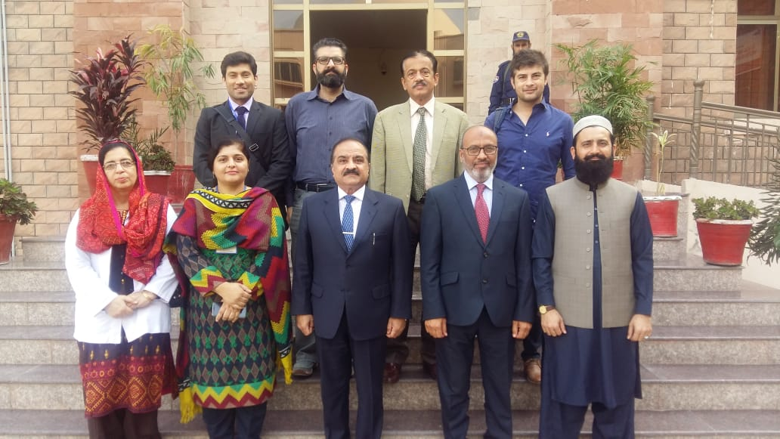

Slide 27
Visit for LIMS
Visit to NIH for LIMS assessmsent
Visit of Mr Ali and team to KMU
Visit of Mr Ali’s technical team to KMU

Slide 29
Yasar Yousafzai,Quratul Ain Wahid³, Shahtaj KhanAwal Meer⁴, Arshad Khan⁵, Tehmina Jalil⁴, Asif Ali^{1,3}, Sadia Fatima¹, Fazle Raziq
¹Institute of Basic Medical Sciences, Khyber Medical University.
²Institute of Infection, Immunity and Inflammation, University of Glasgow.
³Institute of Cancer Sciences, University of Glasgow.
⁴Department of Pathology, Khyber Girls Medical College.
⁵Department of Haematology, Rehman Medical Institute.

